Slide 1

Utilizing Machine Learning to Identify Fraudulent Activities through Analysis of Financial and Communication Data
Group 12
Presenter: Lin Xiaojian
Group Member
Lin Xiaojian（Leader）
Li Zhaochen
Liang Xinwen
Liu Jialin
Yan Shaochong

Slide 2
Table of Content
01
Project Goal
02
Exploring the Dataset
03
Feature Selection
04
Determine Algorithm
05
Validation and Evaluation
06
Conclusion

Slide 3

01
Project Goal

Slide 4




Project Goal
Project Objective
Perfect Concept
Analysis Process
Model Evaluation and Optimization
Dataset Objective

Slide 5

Background
Why Enron？
In late 2001, Enron, an American energy company, filed for bankruptcy after one of the largest financial scandals in corporate history. After the company's collapse, over 600,000 emails generated by 158 Enron employees - now known as the Enron Corpus.
Today, the Enron Corpus is the largest and one of the only publicly available mass collections of data easily accessible for study.

Slide 6

Why Machine Learning？
Machine Learning is an incredibly effective field when it comes to making predictions from data, especially large amounts of it. For example, the Enron Corpus, after cleaning, has around 500,000 emails, and attempting to identify fraudulent employees by manually foraging through half a million emails is a daunting task at best.

Slide 7
02
Exploring the Dataset

Slide 8

21 Features
['salary', 'to_messages', 'deferral_payments', 'total_payments', 'exercised_stock_options', 'bonus', 'restricted_stock', 'shared_receipt_with_poi', 'restricted_stock_deferred', 'total_stock_value', 'expenses', 'loan_advances', 'from_messages', 'other', 'from_this_person_to_poi', 'poi', 'director_fees', 'deferred_income', 'long_term_incentive', 'email_address', 'from_poi_to_this_person']
01
In the features, the boolean poi denotes whether the person is a person of interest or not. It is the most important variable. The Poi_count function shows that there are 18 such people in the dataset, and the aim of this project is to find distinguishing features that set these people apart from the others.
Of course, not everyone has data for each feature, and missing data is denoted by 'NaN'. The NaN_count function prints a dictionary sorted in descending order.

Slide 9
03
Feature Selection

Slide 10
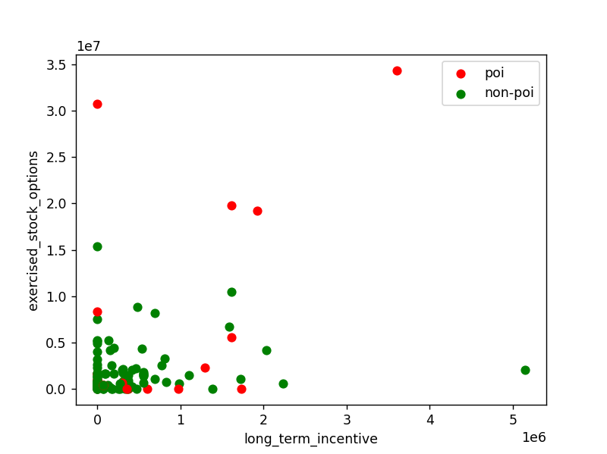
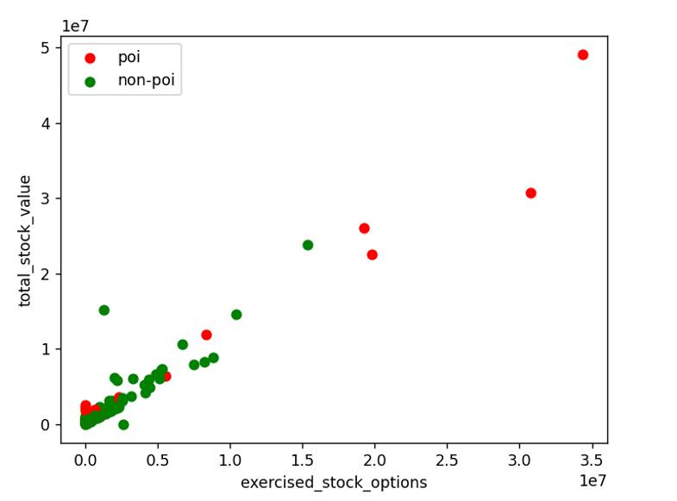
Visualizing Data
Simply create a graph of any two features and visualize them, looking for distribution and getting a general idea of how the data changes. This is a good way to show the relationship between variables.
exercised_stock_options vs long_term_Incentive
total_stock_value vs exercised_stock_options
Basically linear correlation

Slide 11
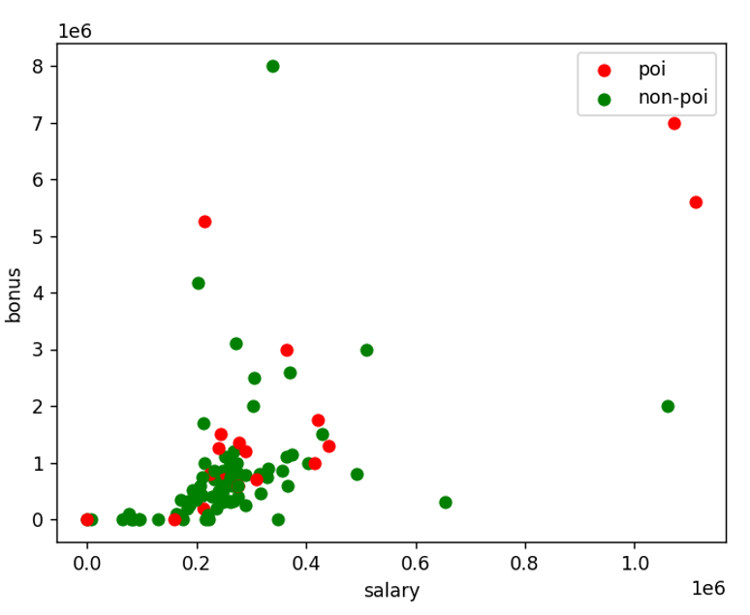
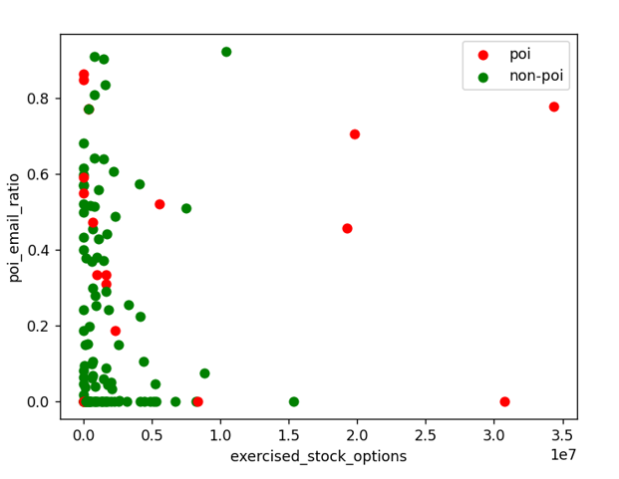
Visualizing Data
salary vs bonus
exercised_stock_options vs poi_email_ratio

Slide 12
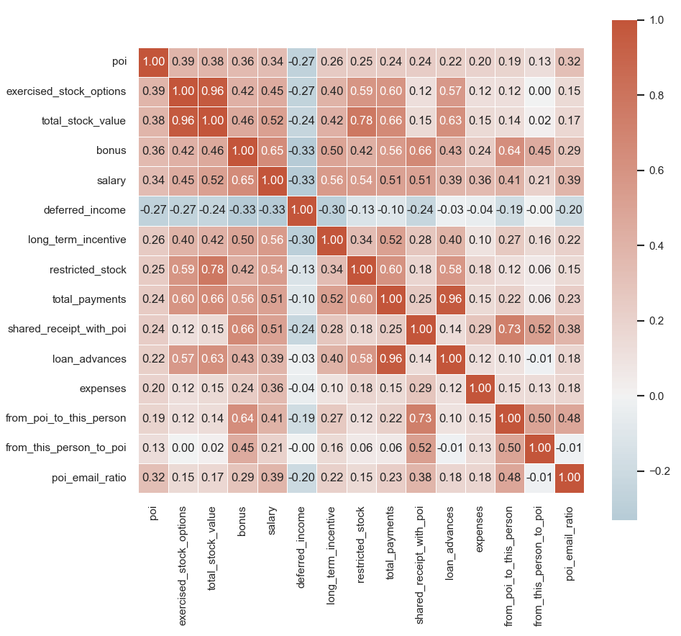
Visualizing Data
Heatmap of Correlation Coefficients of all Feature Terms

Slide 13
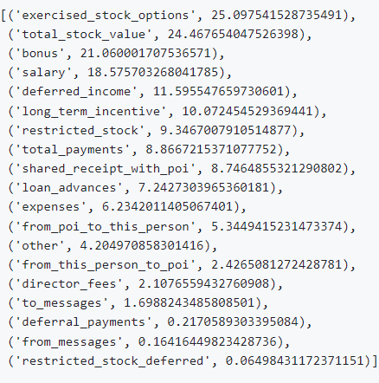
Select K Best and Feature Creation
Our first step is to check the ability of each feature in clearly differentiating between POI and non-POI. To do this, we are going to use Scikit-Learn's SelectKBest algorithm, which will give me a score for each feature in it's ability to identify the target variable.
In select_k_best.py, the Select_K_Best function returns an array of k tuples in descending order of its score. Running this will show the most useful features and the not-so-useful ones. Running them over all features gives:
The first thing we notice is that ‘other’ is not very useful and also ambiguous, so it‘s not a feature we are going to add to the list.

Slide 14
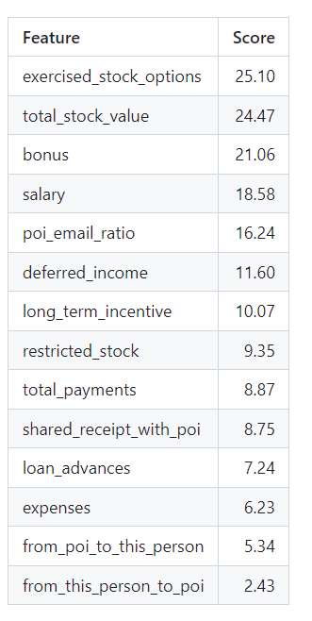
Select K Best and Feature Creation
The final 14 features to be used for the machine learning process are:

Slide 15
04
Determine Algorithm

Slide 16
Machine Learning Algorithm
Decision Tree
K-Nearest Neighbours
1
6
Support Vector Machine
2
5
Adaboost
3
4
Random Forest
Neural Network

Slide 17
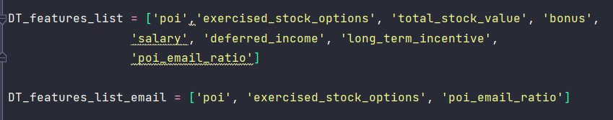
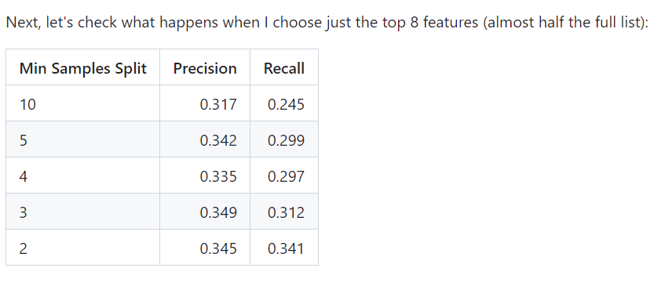
Select Features for ML Algorithm Process
After comparing with all the feature pairs, we decided to try just 3 features.
The best financial feature, 'exercised_stock_options', and the best email feature, 'poi_email_ratio'. a feature list of ['poi', 'exercised_stock_options', 'poi_email_ratio'].

Slide 18
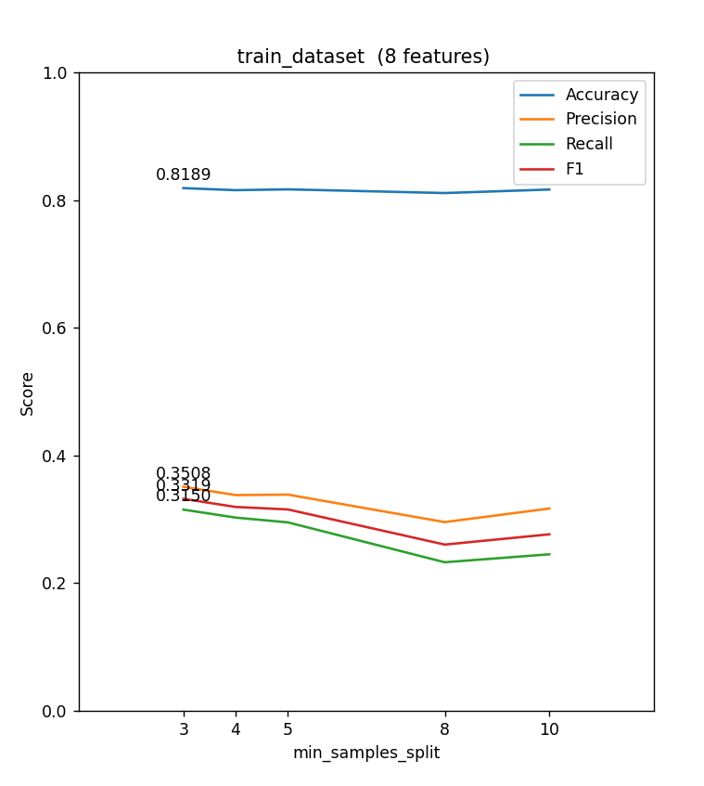
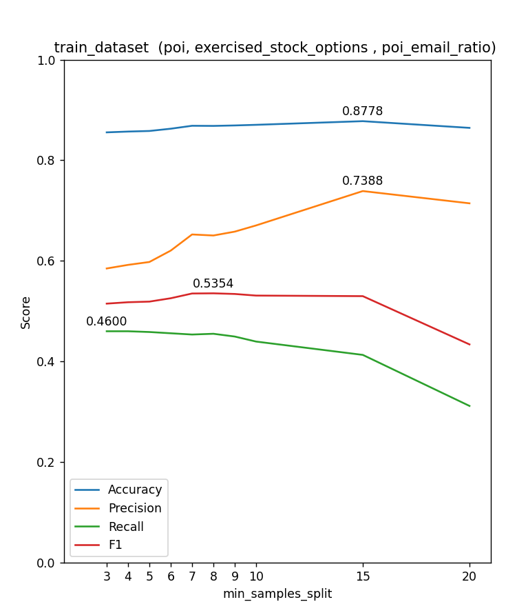
Select Features for ML Algorithm Process

Slide 19
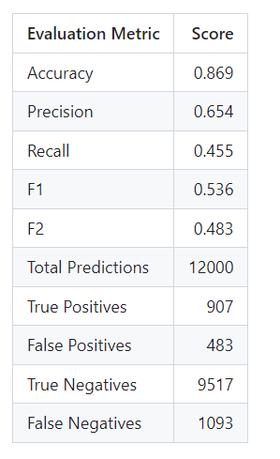
Select ML Algorithm Model
After calculation and comparison of various ml algorithms, the algorithm We've chosen is a Decision Tree Classifier with 'min_samples_split' value of 8 and a feature list of ['poi', 'exercised_stock_options', 'poi_email_ratio'].

Slide 20
05
Validation & Evaluation

Slide 21
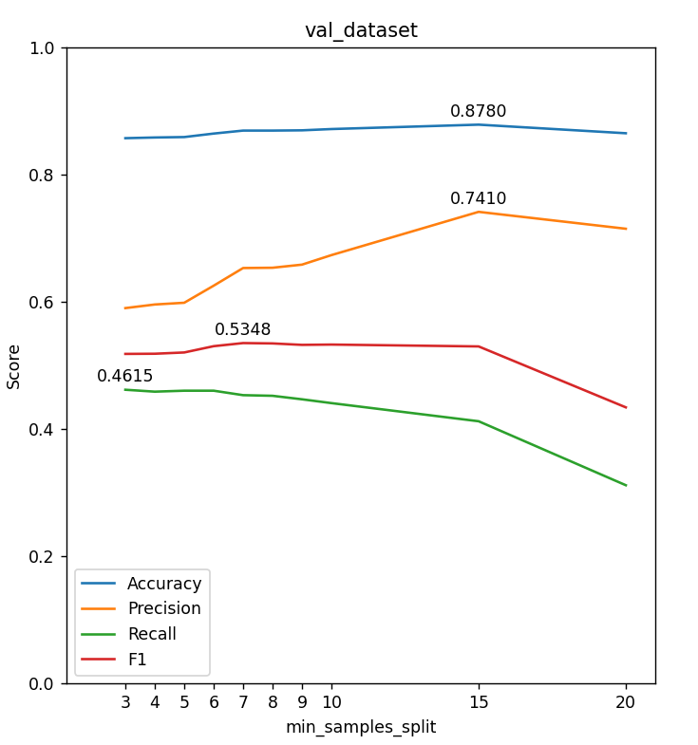
Validation & Evaluation
Use StratifiedShuffleSplit for the validation set.
At min_samples_split = 8, one of the reasons we chose min_samples_split was that F1 had the highest score.
It is F1 that takes into account both the accuracy rate and the recall rate, so that the performance of the classification model can be evaluated more comprehensively.
F1 = 2 * (Precision * Recall) / (Precision + Recall)

Slide 22
06
Conclusion

Slide 23

Conclusion
Based on the financial and email data combing with our ML model, we identified Enron employees who might have committed fraud.

Slide 24
Future Work
1. Tune Parameters
2. More ML Models
3. Innovation of Specific Model
30%
50%
70%
90%

Slide 25
Thanks for Listening

